Slide 1

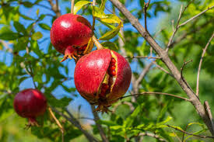
From Shallow CNNs to Object Detection: YOLOv5 Sets a New Standard for Fruit Disease Classification
Presented by :
Mentors :
Madhav Gaba
Shorya Gupta
Aman
Dr. Raman Goyal
(CSED Department)
Group No : 34(b)

Slide 2

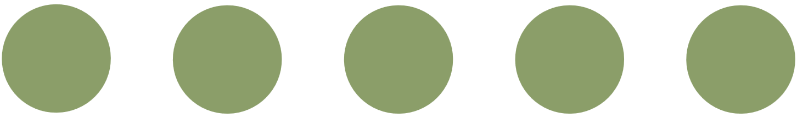
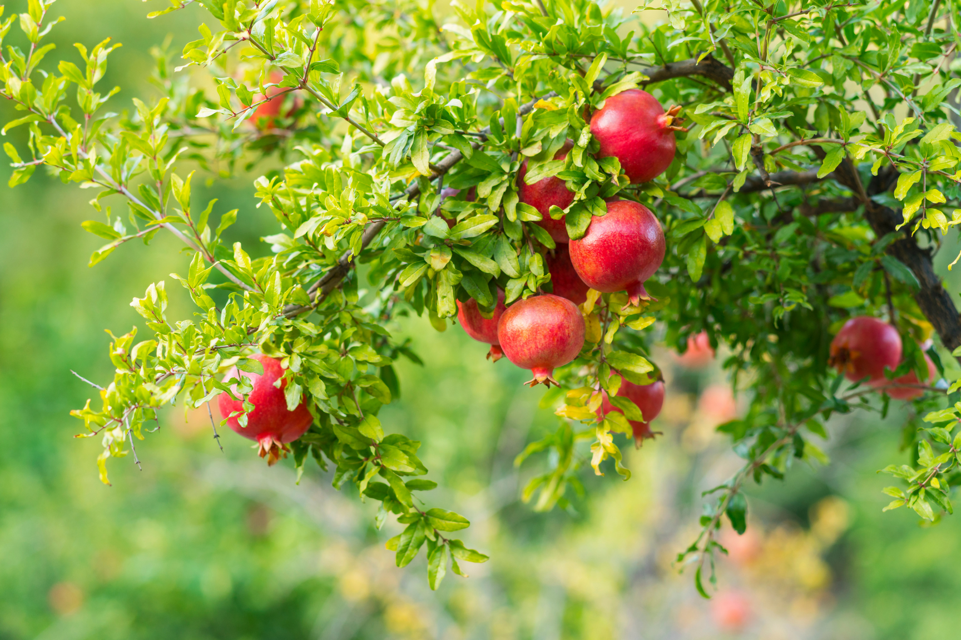

INTRODUCTION
Pomegranate is a high-value crop and major horticultural export from India.
Highly vulnerable to fungal and bacterial diseases, especially in monsoon/humid seasons.
Diseases often remain undetected until symptoms are visible, causing major crop losses.
Current detection methods rely on manual inspection and delayed treatment.
Small and marginal farmers lack access to experts, diagnostic labs, or advanced tools.
Highlights the need for an accessible, cost-effective, automated image-based detection system.

Slide 3

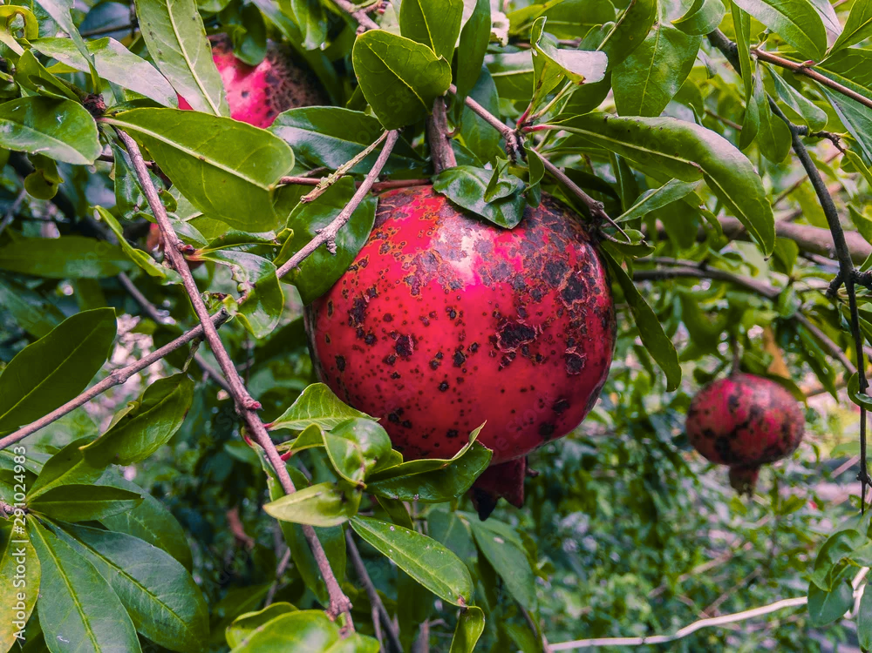
PROBLEM OVERVIEW
Deep learning–based solution for automated detection of pomegranate leaf diseases.
MODELS USED:
Baseline CNN
PDD-TLDCNN (transfer learning–driven hybrid model)
SIFFD-DSGAN (feature fusion with data synthesis)
YOLOv5 (lightweight object detection)
Custom dataset with 5 disease categories used for training and evaluation.
Dummy bounding boxes applied to convert classification task into detection for YOLOv5.

Slide 4



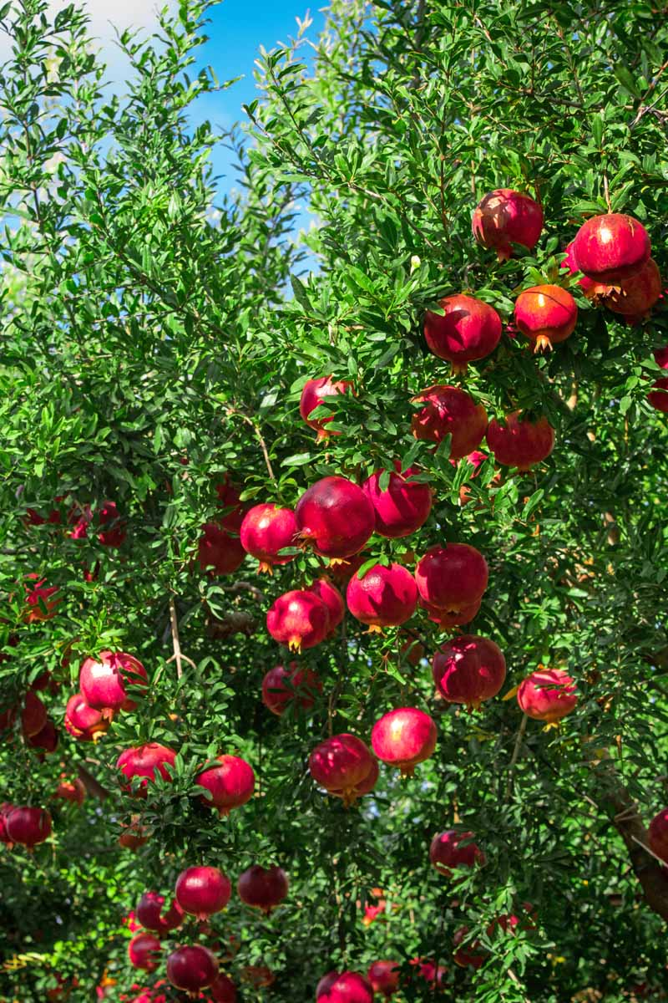
OBJECTIVES
Developed a deep learning system to detect pomegranate leaf diseases automatically.
Used four models: CNN, PDD-TLDCNN, SIFFD-DSGAN, and YOLOv5.
Dataset included 5 disease classes of pomegranate leaves.
Dummy bounding boxes enabled object detection with YOLOv5.
Compared models for accuracy and efficiency in disease detection.
Benchmark four models on custom dataset to identify the most accurate disease detection approach.
Assess each model’s performance in terms of classification accuracy, speed, and deployment readiness.
Select YOLOv5 as the optimal model for scalable, fast, and reliable disease identification.

Slide 5
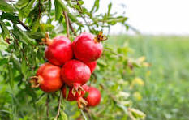
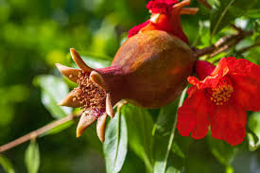
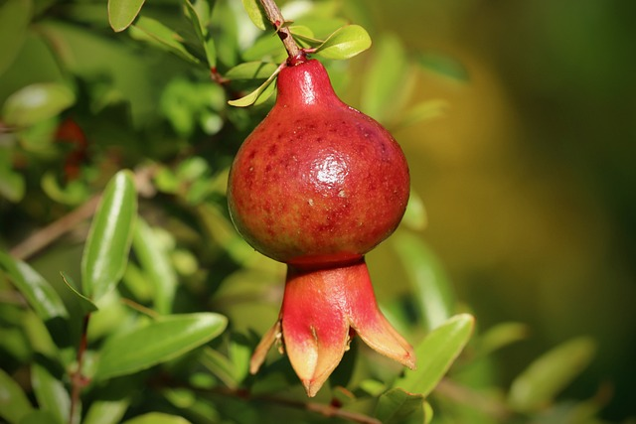
CHALLENGES FACED
Mismatch in label quality
Image Quality issue
Overfitting due to small
dataset
GPU memory limits on
Colab
Need for robust
validation
Class Imbalance

Slide 6
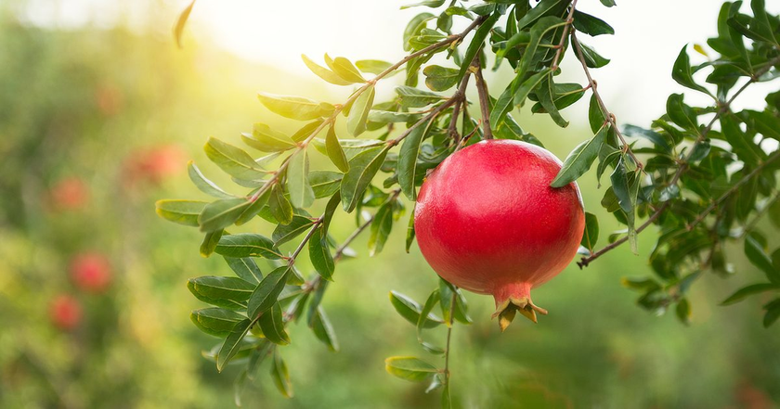
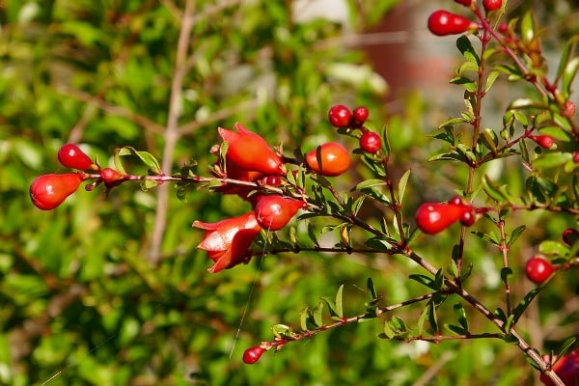
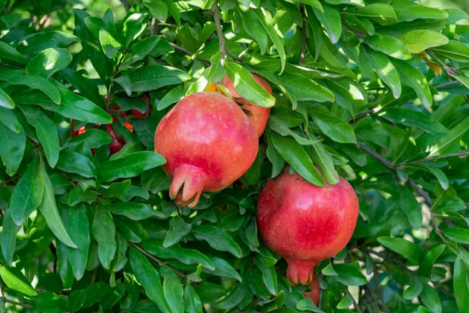
OUR DATASET
Pomegranate Disease Dataset Summary:
Images: 3,228 total images
Classes: 5 classes (Alternaria, Anthracnose, Bacterial Blight, Cercospora, Healthy)
Data Type: RGB images (leaf-level)
Source: Collected from real farm environments
Annotation: Dummy bounding boxes for detection-based training
Format: JPEG images with labeled folders (one per class)
Image Dimensions: Varying resolutions (resized during preprocessing)
Dataset Link: https://www.kaggle.com/datasets/aman0515643/pomegranate-disease

Slide 7
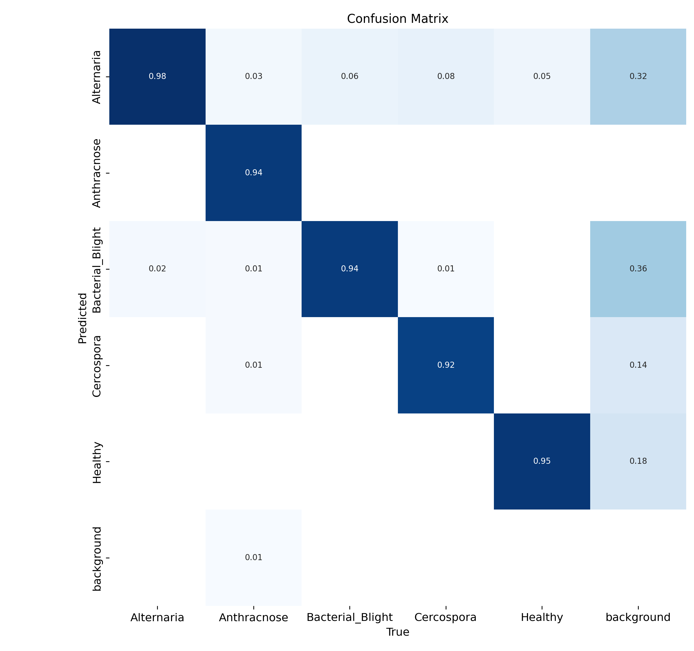
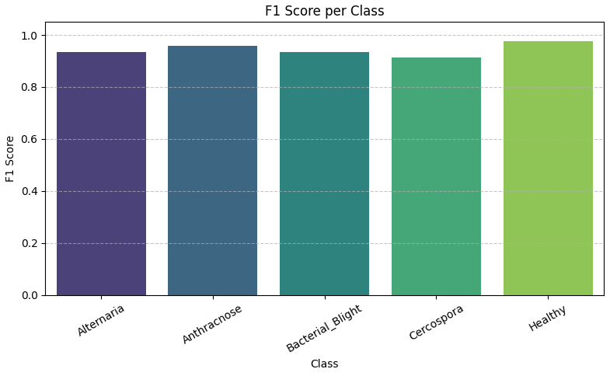
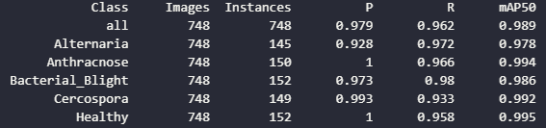
YOLOv5(Accuracy:98.9%)
Annotated dataset (dummy bounding boxes)
Custom training with 5-class model
Fastest inference among all models
Real-time object detection and classification
Result: Best performance — ideal for real-world deployment

Slide 8
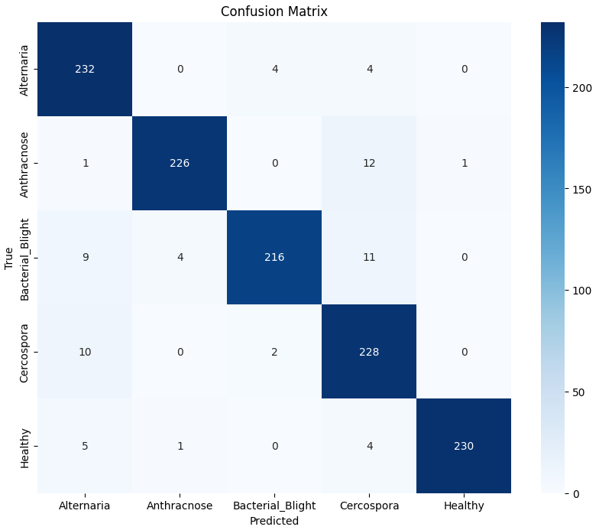
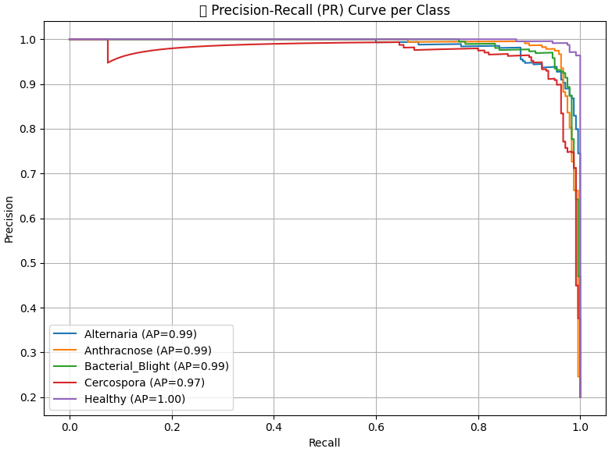
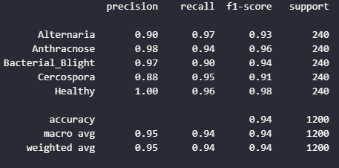
SPDD-TLDCNN(Accuracy:94.33%)
Transfer learning (MobileNetV2)
Dilated convolutions for spatial context
Dense connectivity for deep feature reuse
Extensive data augmentation
Result: Strong balance of accuracy and generalization

Slide 9
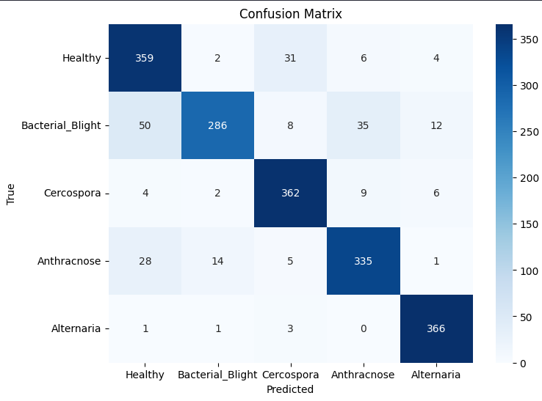
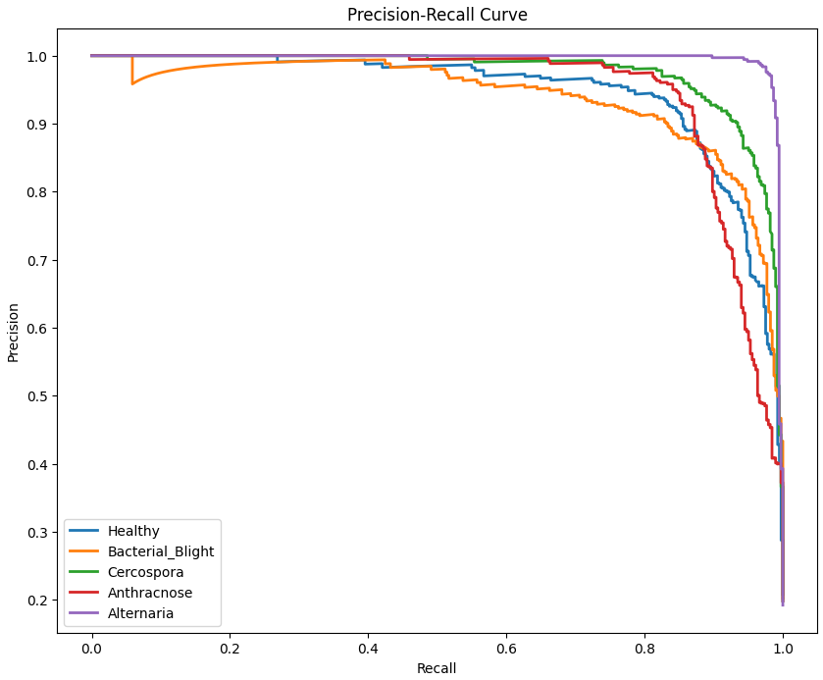
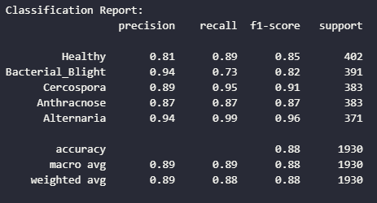
EFDDNN-EI(Accuracy:88.50%)
Dataset preprocessing & augmentation
Environmental data (dummy integration)
Deep CNN with dropout & batch normalization
Multiple dense layers for robust classification
Result: Good performance with integrated environmental features

Slide 10
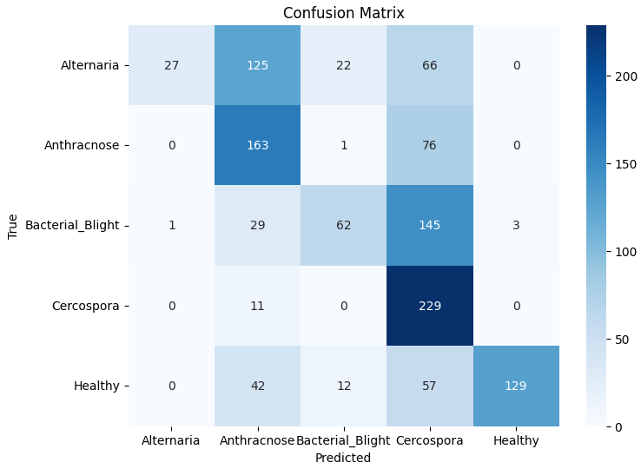
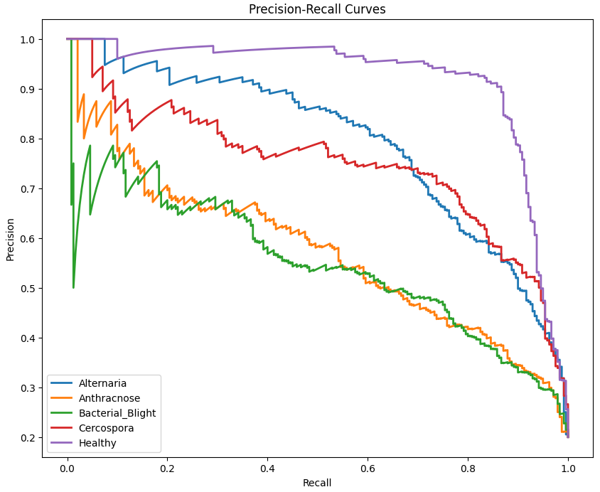
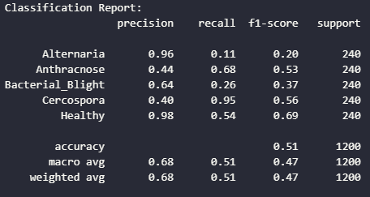
SIFFD-DSGAN(Accuracy:50.83%)
Data split with splitfolders
Synthetic data generation using GANs
Custom CNN with scale-invariant dense fusion layers
Trained using Adam optimizer with callbacks
Result: Low accuracy due to class imbalance and overfitting

Slide 11
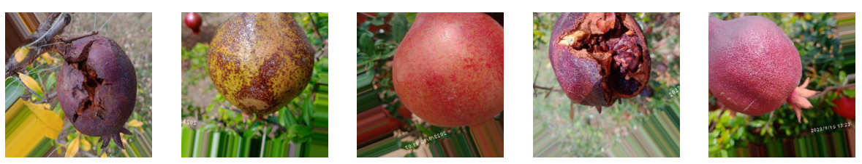
CONCLUSION
Among the four models evaluated — SIFFD-DSGAN (50.83%), EFDDNN-EI (88.50%), PDD-TLDCNN (94.33%), and YOLOv5 (97.91%) — YOLOv5 proved the most effective for pomegranate disease detection.
Unlike classification models that lack spatial awareness, YOLOv5 treats the task as object detection, enabling it to localize diseased regions, handle multiple infections, and achieve faster, real-time inference.
Despite using dummy annotations, it learned strong spatial features, delivering the highest accuracy. Its scalability, precision, and deployment readiness make YOLOv5 the best fit for real-time agricultural applications.

Slide 12
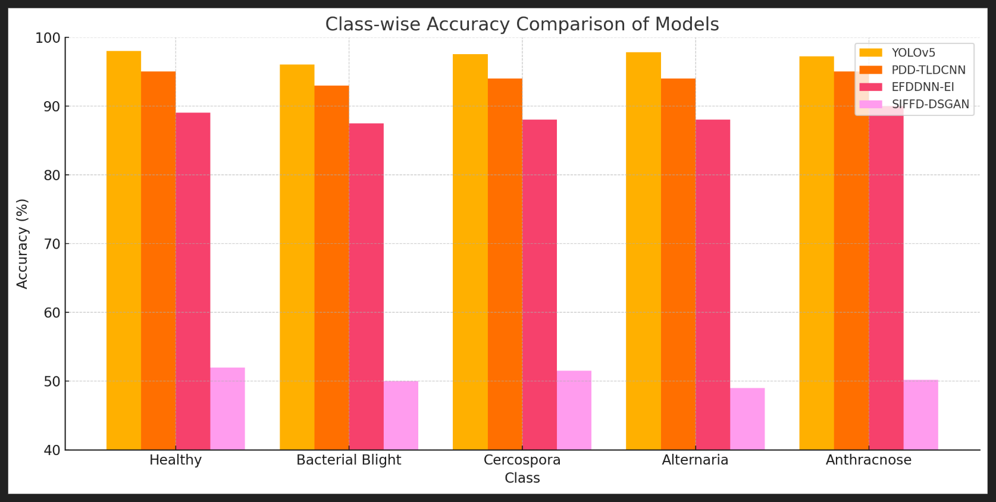
Class-Wise Accuracy Comparison of Models

Slide 13
REFERENCES
https://www.sciencedirect.com/science/article/pii/S0957417425021785
https://www.kaggle.com/datasets/aman0515643/pomegranate-disease
https://wandb.ai/anonymousking23301-thapar-university/YOLOv5?nw=nwuseranonymousking23301
https://ieeexplore.ieee.org/document/9781688
https://ieeexplore.ieee.org/document/9358541

Slide 14
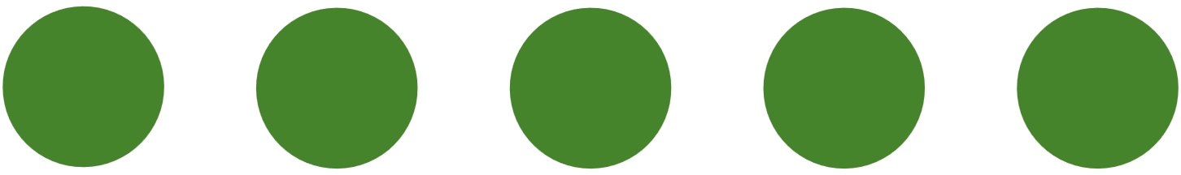
THANK YOU

